Slide 1
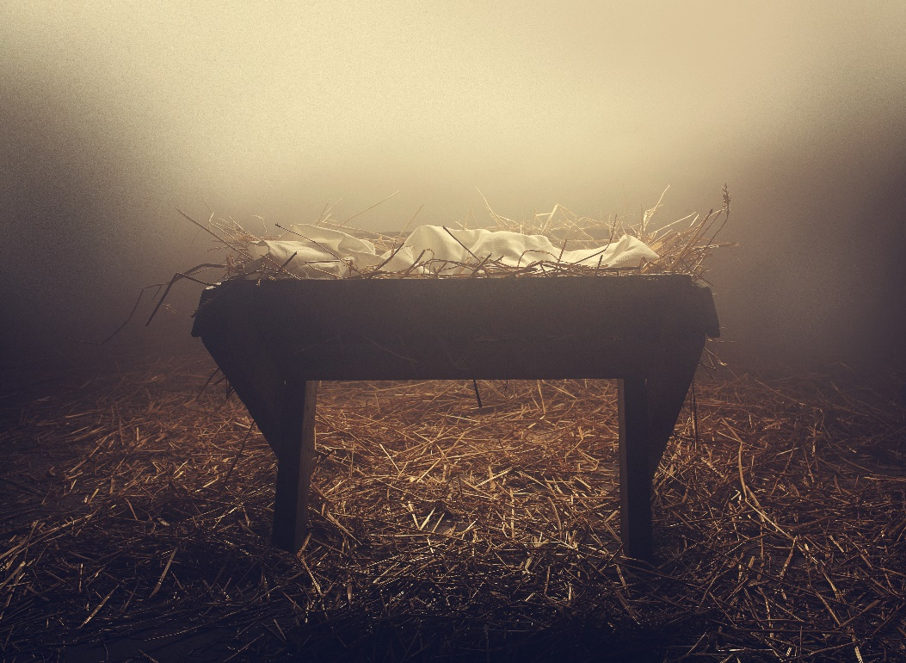
The Savior King
A Christmas Prophecy
Isaiah 9:6-7

Slide 2
The Savior King
“For unto us a Child is born, unto us a Son is given; And the government will be upon His shoulder. And His name will be called Wonderful, Counselor, Mighty God, Everlasting Father, Prince of Peace…”

Slide 3
The Savior King
“Of the increase of His government and peace there will be no end, upon the throne of David and over His kingdom, to order it and establish it with judgment and justice from that time forward, even forever. The zeal of the Lord of hosts will perform this.” (Isaiah 9:6-7)

Slide 4
The Savior King
“a child” – His Humanity
He is the Son of Man
“a son” – His Deity
He is the Son of God
“the government” – His Rule
He is the King of kings
Notes:
.

Slide 5
The Savior King
“he will be called” – His Kingdom
He is:
A Kingdom Without:
“Wonderful
Counselor ”
Confusion
“Mighty God”
Chaos
“Everlasting Father”
Complexity
“Prince of Peace”
Conflict

Slide 6
The Savior King
“of the increase of his government and peace there will be no end”
The Extent of His Kingdom
The Everlasting God
“He will reign on David’s throne and over his kingdom”
His Promise
The King of David

Slide 7
The Savior King
“establishing and upholding it with justice and righteousness for that time and forever”
His Righteous Character
The Lord our Righteousness

Slide 8
The Savior King
“the Zeal of the Lord Almighty will accomplish this”
His Determination
The Lord who Provides

Slide 9
The Savior King
A Christmas Lineage
Matthew 1:1-17
Notes:
The Purpose of this section is to show that Jesus “Yahweh Saves” had a claim to the throne of Israel through His Messianic ancestry. Matthew gives evidence that Jesus inherited the legal right to rule through stepfather Joseph. Jesus could claim the right to kingship because He was the son of David, king of Israel.

Slide 10
The Savior King
Jesus, the King of Israel
Near the Beginning:
“…the wise men from the East came to Jerusalem, saying, "Where is He who has been born King of the Jews? (2:2)

Slide 11
The Savior King
Jesus, the King of Israel
Near the End:
The superscription on the cross, “This is Jesus, the King of the Jews” (27:37)

Slide 12
The Savior King
“And behold, you will conceive in your womb and bring forth a Son, and shall call His name Jesus. He will be great, and will be called the Son of the Highest; and the Lord God will give Him the throne of His father David. And He will reign over the house of Jacob forever, and of His kingdom there will be no end.” (Luke 1:31-33)

Slide 13
The Savior King
Jesus, the King of Israel
Introduction to the King (1-4)
Proclamations of the King (4-7)
Power of the King (8-11)
Growing Opposition of the King (11-16)
Preparation of the King’s Disciples (16-20)
Public Presentation of the King (20-21)
Final Rejection of the King (21-27)
Triumph of the King (28)
Notes:
Matthew introduces the reader to the King from His birth to the beginning of His ministry, summarizes His royal proclamations (Sermon on the Mount) gives evidence of authority of the king over the world traces both the initial popularity to growing opposition to His eventual rejection by His crucifixion, but ends with the King’s triumph over death itself.

Slide 14
The Savior King
Matthew’s Purpose
First: God promises to deliver Israel from Gentile oppression.
Second: to explain why the Kingdom has not come and has been delayed.
Notes:
First: to remind his readers that God has been (1st Coming) and will be faithful (2nd Coming) to His promise to David and to Abraham by sending Jesus to deliver Israel from Gentile oppression.
Second: to explain why the Messianic Kingdom has not come and has been postponed or delayed because of Israel rejection of her King.

Slide 15
The Savior King
Matthew’s Purpose
Third: to explain the new program (the Church) God instituted in light of Israel’s rejection until the 2nd Coming.
Forth: to inform believers what they are to do during this time, also know as “the times of the Gentiles”.
Notes:
First: to remind his readers that God has been (1st Coming) and will be faithful (2nd Coming) to His promise to David and to Abraham by sending Jesus to deliver Israel from Gentile oppression.
Second: to explain why the Messianic Kingdom has not come and has been postponed or delayed because of Israel rejection of her King.
Third: to explain the new program (the Church) God instituted in light of Israel’s rejection until the 2nd Coming.
Forth: to inform believers what they are to do during this time, also know as “the times of the Gentiles”. Followers of Jesus are to be on the alert, waiting patiently for His imminent return, loving and serving one another, and following the Kings ethical instructions based on God’s holy character.

Slide 16
The Savior King
Jesus, the Savior
An angel tells Joseph in a dream the Mary “will bring forth a Son, and you shall call His name Jesus, for He will save His people from their sins.” (1:21)

Slide 17
The Savior King
Jesus, the Savior
The angels announced to the shepherds, “For there is born to you this day in the city of David a Savior, who is Christ the Lord.” (Luke 2:11)

Slide 18
The Savior King
Jesus, the Savior
The Samaritans said after hearing Jesus for themselves “…we ourselves have heard Him and we know that this is indeed the Christ, the Savior of the world.” (John 4:42)

Slide 19
The Savior King
Jesus, the Savior
“For God did not send His Son into the world to condemn the world, but that the world through Him might be saved.” (John 3:17)
Notes:
At His first coming Jesus came to seek and save the lost (Luke 19:10) He came riding on a donkey. At His second coming He comes riding on a white horse judging and to make war, welding a sharp sword with which He will strike the nations.
All who take believe and Him may take refuge in Him as a rock of salvation, the chief cornerstone, but those who willing refuse to trust in Him will stumble over Him and will be crushed by Him.

Slide 20
The Savior King
“The Spirit of the Lord God is upon Me, because the Lord has anointed Me to preach good tidings to the poor; He has sent Me to heal the brokenhearted, to proclaim liberty to the captives, and the opening of the prison to those who are bound; To proclaim the acceptable year of the Lord,”
Notes:
At this point Luke says Jesus sat down and said, “Today this Scripture is fulfilled in your hearing” (Luke 4:21) But Isaiah comes on to say…

Slide 21
The Savior King
“The Spirit of the Lord God is upon Me, because the Lord has anointed Me to preach good tidings to the poor; He has sent Me to heal the brokenhearted, to proclaim liberty to the captives, and the opening of the prison to those who are bound; To proclaim the acceptable year of the Lord, and the day of vengeance of our God;” (Isaiah 61:1-2a)
Notes:
“and the day of vengeance of our God.” Jesus did not read that portion because that day was not yet the day of the vengeance, the day of the Lord.

Slide 22
The Savior King
“The book of the genealogy of Jesus Christ, the Son of David, the Son of Abraham:” (1:1)
Matthew records his central theme and character, Jesus, the Christ. From the opening verse he connects Him back to the two great covenants in Jewish history…

Slide 23
The Savior King
“The book of the genealogy of Jesus Christ, the Son of David, the Son of Abraham:” (1:1)
The Davidic Covenant
2 Samuel 7
The Abrahamic Covenant
Genesis 12, 15
Notes:
If Jesus had come to fulfill these two great covenants then He would have to be from the rightful line.

Slide 24
The Savior King
“When your days are fulfilled and you rest with your fathers, I will set up your seed after you, who will come from your body, and I will establish his kingdom. He shall build a house for My name, and I will establish the throne of his kingdom forever.” (2 Samuel 7:12-13 )
The Davidic Covenant

Slide 25
The Savior King
“I will be his Father, and he shall be My son. If he commits iniquity, I will chasten him with the rod of men and with the blows of the sons of men. But My mercy shall not depart from him, as I took it from Saul, whom I removed from before you.” (7:14-15)
The Davidic Covenant

Slide 26
The Savior King
“And your house and your kingdom shall be established forever before you. Your throne shall be established forever.” (7:16)
The Davidic Covenant

Slide 27
The Savior King
“Also I will make him My firstborn, the highest of the kings of the earth. My mercy I will keep for him forever, and My covenant shall stand firm with him. His seed also I will make to endure forever, and his throne as the days of heaven.” (Psalm 89:27-29 )
The Davidic Covenant

Slide 28
The Savior King
“If his sons forsake My law and do not walk in My judgments, if they break My statute and do not keep My commandments, then I will punish their transgression with the rod, and their iniquity with stripes. Nevertheless My lovingkindness I will not utterly take from him…” (89:30-33)
The Davidic Covenant

Slide 29
The Savior King
“My covenant I will not break, nor alter the word that has gone out of My lips. Once I have sworn by My holiness; I will not lie to David: His seed shall endure forever, and his throne as the sun before Me; It shall be established forever like the moon, even like the faithful witness in the sky.” (89:34-37)
The Davidic Covenant

Slide 30
The Savior King
“Now the Lord had said to Abram: ‘Get out of your country, from your family and from your father's house, to a land that I will show you. will make you a great nation; I will bless you and make your name great; And you shall be a blessing…” (Genesis 12:1-2)
The Abrahamic Covenant
Notes:
The ultimate fulfillment of this covenant identifies Jesus as the promised seen of Abraham who makes available to everyone the blessings of salvation.

Slide 31
The Savior King
The Tale of Two Genealogies
Matthew gives Jesus lineage through His legal father, Joseph (1:1-17)
Luke gives Jesus lineage through His physical mother, Mary (3:23-38)
Notes:
Matthew’s genealogy traces Jesus’ legal right to the throne of David, which must come through Solomon and his descents. Luke’s genealogy traces Jesus’ physical right to the throne of David through another son of David, named Nathan (Luke 3:31)

Slide 32
The Savior King
The Tale of Two Genealogies
The Curse of Jeconiah
“Thus says the Lord: 'Write this man down as childless, a man who shall not prosper in his days; For none of his descendants shall prosper, sitting on the throne of David, And ruling anymore in Judah.” (Jeremiah 22:23)
Notes:
If Jesus had been a physical descendent of Jeconiah He would not of been able to occupy the throne of David.

Slide 33
The Savior King
Nathan
Mary
David
Physical Right
Jesus
Solomon
Coniah
Joseph
Legal Right
Mary was of David’s line through Nathan giving Jesus the physical right to the throne.
Joseph was of David’s line through Solomon giving Jesus the legal right to the throne.

Slide 34
The Savior King
“The book of the genealogy of Jesus Christ, the Son of David, the Son of Abraham:” (1:1)
“So all the generations from Abraham to David are fourteen generations, from David until the captivity in Babylon are fourteen generations, and from the captivity in Babylon until the Christ are fourteen generations.” (1:17)

Slide 35
The Savior King
“The book of the genealogy of Jesus Christ, the Son of David, the Son of Abraham:” (1:1)
Abraham David the King
David the King Jeconiah
Jeconiah Jesus, the Christ

Slide 36
The Savior King
“The book of the genealogy of Jesus Christ, the Son of David, the Son of Abraham:” (1:1)
Abraham David the King
From Abraham to Jesse describes the period when God was preparing to set up the Davidic Kingdom.

Slide 37
The Savior King
“The book of the genealogy of Jesus Christ, the Son of David, the Son of Abraham:” (1:1)
David the King Jeconiah
From David to Jeconiah describes the period when God exhibited the presence of the kingdom when it was under Israel’s sovereign control.
Notes:
This period exhibited the presence and the glory of the Kingdom. Out of Abraham’s seed (Israel) came a royal line (Judah [Gen. 49:9-12]) At that time God made a covenant with David (2 Sam. 7:16) promising him an unending dynasty and an everlasting kingdom.

Slide 38
The Savior King
“The book of the genealogy of Jesus Christ, the Son of David, the Son of Abraham:” (1:1)
Jeconiah Jesus, the Christ
From Jeconiah to Jesus describes the period when God postponed the kingdom and removed it from Israel’s sovereign control.
Notes:
When Jesus began His ministry He came and He offered the kingdom to the nation, with two condition, the nation as a whole had to repent of their sins and believe in Him as their Messianic King.

Slide 39
The Savior King
“From that time Jesus began to preach and to say, "Repent, for the kingdom of heaven is at hand.” (4:17)
“εγγιζω” - “eggizo” means:
“near” not “here”
“within your grasp”
“to keep and bear arms”

Slide 40
The Savior King
The Kingdom was offered with sufficient evidence through signs and wonders (4-12) of Jesus’ right to rule as the King of David. But the King was rejected, “the Pharisee sought to destroy Him.” (12:14)
At this juncture Jesus began to speak of declaring justice to the Gentiles and the Gentiles believing in His name.” (12:18-21)

Slide 41
The Savior King
After healing a blind and mute man… “and all the multitudes were amazed and said, “Could this be the Son of David?” (12:23)
The Pharisee rejected this claim, saying instead He preforms this by the power of the ruler of the demons (12:24)

Slide 42
The Savior King
Jesus called the generation of Jews with which he was speaking, “this wicked generation” (12:23)
“Therefore I say to you, the kingdom of God will be taken from you and given to a nation bearing the fruits of it.” (21:43)

Slide 43
The Savior King
Jesus, “presented Himself alive after His suffering by many infallible proofs, being seen by them during forty days and speaking of the things pertaining to the kingdom of God.” (Acts 1:3)
“Therefore, when they had come together, they asked Him, saying, "Lord, will You at this time restore the kingdom to Israel?” (Acts 1:6-7)
Notes:
Previously the disciples had been confused and befuddled about what Jesus had taught. We often read that “they did not understand these things at first.” or “they were afraid to ask”. But after His death and resurrection, at that time had opened their minds to understanding the Scriptures (Lk. 24:45) Now after been instructed for 40 days concerning the Kingdom of God and with opened minds they then ask this question…

Slide 44
The Savior King
First: they expected a literal kingdom.
Second: they expected the Kingdom to be given to Israel.
Third: they knew the Kingdom was still future.
Fourth: they expected His return to be before the Kingdom was established
“Lord, will You at this time restore the kingdom to Israel?”
Notes:
They did not think the kingdom was already inaugurated in heaven (i.e., Amillenialism). Nor did they believe Jesus would return after the kingdom had already started i.e., Postmillenialism). They expected Jesus would be there at the beginning before it starts (i.e., Premillenialism) in order to establish the kingdom personally.

Slide 45
The Savior King
Did the Disciple get it wrong?
Some commentators say the disciples were being carnal and were still befuddled about the Kingdom. They were clinging to old ideas about Israel’s future and did not realize Jesus repudiated.
“Lord, will You at this time restore the kingdom to Israel?”

Slide 46
The Savior King
Did the Disciple get it wrong?
Howard Marshall suggests the apostles, “has not yet realized that Jesus had transformed the Jewish hope of the Kingdom of God by purging it of its nationalistic elements” Silly apostles.
“Lord, will You at this time restore the kingdom to Israel?”
Notes:
I. Howard Marshall, Acts (Grand Rapids, MI; Eerdmans, 1996), 60.

Slide 47
The Savior King
Did the Disciple get it wrong?
F.F. Bruce wrote, “the apostles were wrong to expect to rule with Christ in a literal kingdom, but they would know better soon enough.”
“Lord, will You at this time restore the kingdom to Israel?”
Notes:
F.F. Bruce, Commentary on the Book of Acts (Grand Rapids, MI; Eerdmans, 1981), 38.

Slide 48
The Savior King
Did the Disciple get it wrong?
John Calvin bluntly wrote, “…marvelous is their rudeness… they had been diligently instructed by the space of three years, they betrayed no less ignorance than if they had heard never a word. There are as many errors in this question as words. They declared how bad scholars they were under so good a Master.”
Notes:
John Calvin, Commentary Upon the Acts of the Apostles, Vol. 1” in Calvin’s Commentaries Vol. 18, trans. Henry Beveridge (Grand Rapids, MI; Baker, 2003), 43.

Slide 49
The Savior King
Did the Disciple get it wrong?
First: Jesus just spent forty days teaching them about the Kingdom.
Second: there minds were supernatu-rally enabled to understand His teaching during that time.
“Lord, will You at this time restore the kingdom to Israel?”
Notes:
The disciples/apostles knew exactly what they were asking, and they were right to ask it. If it is right, then who is it that is really being carnal?

Slide 50
The Savior King
Did the Disciple get it wrong?
C. R. Stam noted, “It is sometimes said that the apostles in asking this question, betrayed carnality and ignorance of the true nature of the Kingdom which the Lord was to establish, but the charge is most unjust. The ignorance and carnality lie, not with the apostles but with their critics.”
Notes:
C. R. Stam, The Book of Acts Dispensationally Considered (Chicago, IL.: Berean Bible Society, 1954); 1:33.

Slide 51
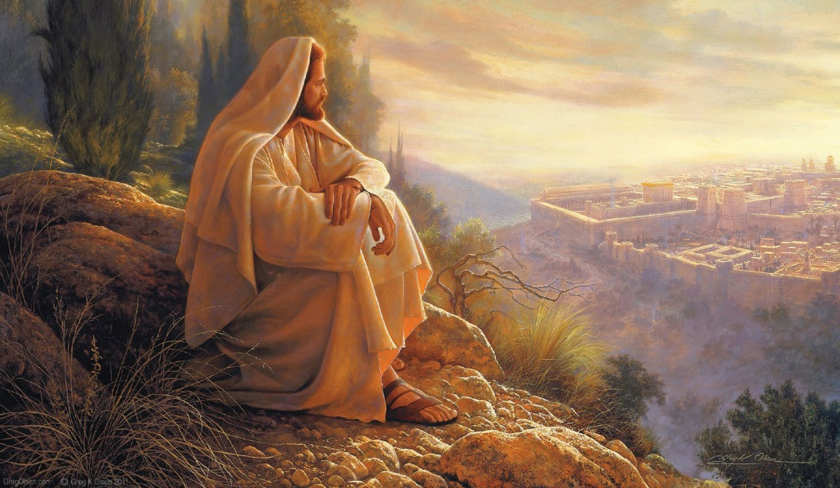
The Savior King
The Disciple Got It Right!
Jesus taught that a literal kingdom for Israel is coming. The apostles expected such a kingdom. So do I and so should you!
Jewish Dream!
Notes:
The Swiss Reformer, Heinrich Bullinger wrote up the Second Helvetic Confession which reads "We also reject the Jewish dream of a millennium, or golden age on earth, before the last judgment."
The Jewish dream also included some real bad sinners and outsiders.

Slide 52
The Savior King
A Tale of Four Outcast Women
Tamar – Incest, Harlot, and Deception
Rahab – Canaanite, Prostitute
Ruth – Moabite, Born in Incest
Bathsheba – Adultery, Murder
Notes:
Matthew includes these less than reputable women in order to emphasize that God is a God of grace, saving sinners. Remember, it takes two tango. It just wasn’t the women who were all bad, it was the guys too, including Judah and David.
You could call this the hall of shame.

Slide 53
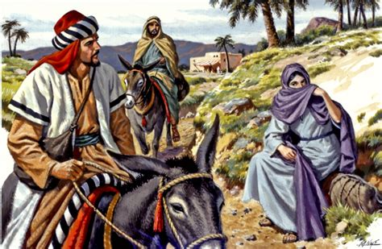
The Savior King
“Abraham begot Isaac, Isaac begot Jacob, and Jacob begot Judah and his brothers. Judah begot Perez and Zerah by Tamar,…”
Genesis 38
Notes:
Judah had taken Tamar as a wife for his firstborn son, Er. But was evil and God stuck him dead. Onan, Er brother then became Tamar as his wife. But God struck him dead too. Frustrated at being childless Tamar concocted an evil scheme to become pregnant. She dressed up and disguised herself as a prostitute and waited Judah to pass by. Judah committed a sinful act of fornication with his own son’s widow. Twin sons were born Perez and Zerah, out of a shameful act of harlotry and incest. Perez carried the messianic line.
“If God would continue the Messianic line through Tamar’s offspring—the product of incest, harlotry, fornication and deception—then He surely is a God of grace.” (John MacArthur, “The Miracle of Christmas” p. 31.

Slide 54
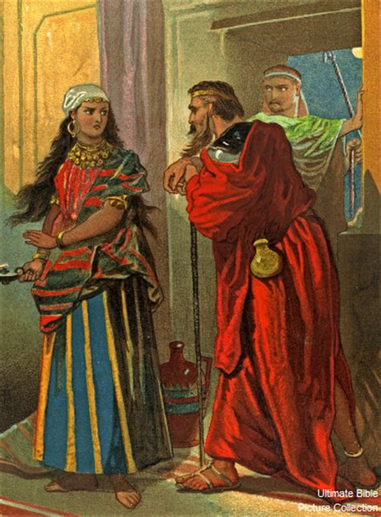
The Savior King
“Salmon begot Boaz by Rahab…” (1:5a)
Joshua 2
Notes:
Rahab was a Canaanite, the mortal enemy of Israel and a prostitute. But she believe God and sought to be saved from what was coming, the total destruction and death..
She hid the spies, though lied about it, to protect them. When the Israelites took the city they spared her life and her family.
She abandoned the gods of the Canaanites for Yahweh. She became a convert to the true God, but also a part of the Messianic line, the great, great grandmother of David.

Slide 55
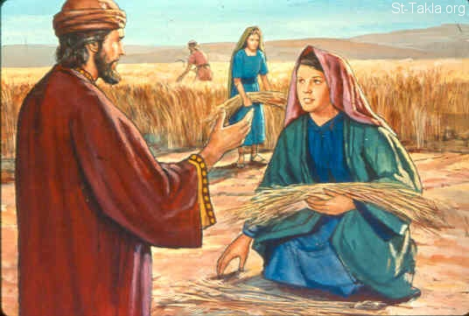
The Savior King
“Boaz begot Obed by Ruth, Obed begot Jesse, and Jesse begot David the king. (1:5b-6)
Genesis 19
Ruth
Notes:
Rahab was the mother of Boaz. A generation later we read that “to Boaz begot Obed by Ruth” another Gentile women in the Messianic line. Ruth was not a prostitute or fornicator, but she was from a people, the Moabites who were born in incest.
Lot’s own daughters got their father drunk and slept with him on two successive nights. They each bore a son, Moab and Ammon. Ruth was a descent of a people derived from incestuous fornication. Yet Ruth became the wife of Boaz. Like Rahab she converted to the truth and found grace/favor with the Lord and became the grandmother of king David.

Slide 56
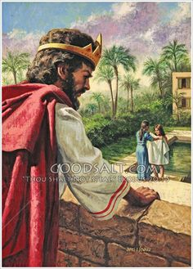
The Savior King
“David the king begot Solomon by her “Bathsheba” who had been the wife of Uriah…” (1:6b)
2 Samuel 11-12
Notes:
Despite the fact of David’s fornication and murder plot, after the child born in fornication died, Bathsheba born a second child, Solomon, who become the next link in the Messianic line. Another act of God’s grace.

Slide 57
The Savior King
A Christmas Lineage
Matthew 1:1-17
Notes:
So we have four women, two of which were harlots, one was a curse Moabite, and another an adulteress, all outcasts. And the all the evil kings of Judah we have a royal line of Jesus filled with sinners. But that is just the point. Jesus Christ is a friend of sinners (Lk. 7:34). Jesus identifies with sinners. And the genealogy puts a spot light on God’s grace.
This is the heart of the Christmas story: God in His mercy forgiving sinner, coming to save His people from their sins (Mt. 1:21)
But wait just one minute! There is a fifth women mention…

Slide 58
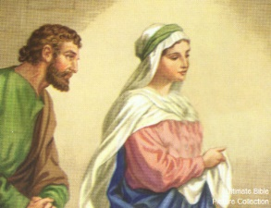
The Savior King
“And Jacob begot Joseph the husband of Mary, of whom was born Jesus who is called Christ.” (1:16)
Mary
Notes:
“…in the genealogy, with a very important change. The genealogy consistently and repeatedly says, “the father of” or “the father begat a son” until it comes to Mary. Matthew now says “of whom was born Jesus”, not “and Joseph begat Jesus”. In addition, “of whom” is feminine relative pronoun clearly indicating that Jesus was the physical child of Mary only, and Joseph was not the physical father of Jesus. Luke says Jesus was the supposed son of Joseph, “Now Jesus Himself began His ministry at about thirty years of age, being (as was supposed) the son of Joseph…”
The miraculous conception and birth of Jesus, the Savior King, is explained in Mt. 1:18-25.

Slide 59
The Savior King
A Christmas Lineage
Matthew 1:1-17
Notes:
Matthew answer the important question a Jew would rightfully ask about anyone who claimed to be King of Israel. Is He the descendent of David through the rightful line of succession? Matthew answer is yes!

